Slide 1
Lecture 11: Measuring Computer Performance
Is referred to as: System metrics or quantifying computer performance
There is need to quantify computer performance
Quantifying means expressing the value of something in numeric form so as to provide further information
Computer performance metrics is quantified to make : comparisons among different computer designs
Determine to benefit and lack of computer design

Slide 2
Why study computer is performance metrics?
Determine the benefit or lack of computer design
What is computer performance?
Latency or response time
Execution time it takes to complete one task
Bandwidth(or throughput)- the number of tasks it takes to complete one task in unit time

Slide 3
What is performance?
Performance is in unit of things per second and bigger is better i.e. the larger the number of units the better
If concern is about response time then:
Performance(x) = $\frac{1}{execution −time (x)}$
X is n times faster than Y
n = $\frac{performance(x)}{Performance(y)}$ = $\frac{Execution −time(x)}{Execution−time (Y)}$

Slide 4
Factors that contribute to computer performance
These include:
Clock Speed of the CPU
Size of RAM
Speed of the hard disk
Hard disk space
Multiple applications running on the computer same time

Slide 5
Clock speed of the CPU
The clock speed of the CPU is the frequency at which the processor executes instructions
It is measured in millions of cycles per second or megahertz (MHz) or in billions of cycles per second (GHZ)
If the Clock speed of the CPU is fast then definitely the performance of the computer will be affected positively, in other words the computer will carry out processing functions at a faster pace.

Slide 6
Size of RAM
RAM stores data that the computer is currently using
It is faster to retrieve data stored in the RAM than from main memory.
A large RAM size will mean a faster computer performance and a smaller RAM size will result to slower computer performance.

Slide 7
Speed of the Hard Disk
The hard disk speed is defined as the rate at which data can be read and written on it.
The speed of different hard disks is not consistent because they vary by manufacturer,
It therefore means that the higher the speed of the hard disk the better the computer performance

Slide 8
Running multiple applications same time
Multi-tasking slow down the performance of the computer because memory is used to support more than one applications compared to when one application has all the memory to itself
This means that the more applications that are running the slower the computer will perform
Likewise if less or one application is running the performance of the computer will be faster.

Slide 9
Bench marks
Benchmarking is the practice of comparing performance metrics to industry bests and best practices from other companies
There are several benchmark types:
Synthetic benchmarks
- Designed to have same mix of operations as real workloads for example Dhrystone (system intended to be representative of system integer programming)

Slide 10
Dhrystone
Has meta data from a broad range of software including programs from FORTRAN, PL1, ALGOL-68 and Pascal
The programs are characterized by common constructs such as:
-Procedure calls
Pointer indirections
Assignments etc.
Has grown to become representative of general CPU performance

Slide 11
Dhrystone
Works on both RISC and CISC instruction sets and represents results more meaningful than MIPS (million instructions per second)
Toy Programs
Are used as bench marks and have advantages of being small, easy to port, output often known before program execution
Examples: Towers of Hanoi, Bubble sort, N Queens etc.

Slide 12
Whetstone benchmark
This bench mark uses floating point arithmetic operations
Kernels
Use common subroutines in real programs e.g. Matrix multiplication, Fast Fourier Transformation(FFT) algorithms, Sorting
Real Applications
People use their computers for car crash, simulations, relational data bases etc.

Slide 13
Computer Arithmetic Range and precision floating point numbers
The range is effectively determined by the number of digits in the exponent
Precision is determined by the number of digits in the fraction
Example of base 10 floating-point number: +6.023 x 10²³
The range is represented by power of ten that is, 10²³
Precision is represented by the digits in the fixed-point number 6.023
+ (Sign), 23 (exponent), 6.023 (Significant)

Slide 14
Problem with floating point numbers
The same number can be represented in different ways
This makes comparisons and arithmetic operations difficult,
Example 3584 x 10¹ can be represented as:
35.84 x 10²
3.584 x 10³
.3584 x 10⁴

Slide 15
Avoiding multiple representations
To avoid these multiple representations of the same number, the number must be normalised
Normalization is done by shifting the radix point to the left or to the right and the exponent must be adjusted accordingly, until the radix point is to the left of the leftmost non-zero
digit.
So the number .3584 x 10⁴ is a normalised one.

Slide 16
Representing floating point numbers in the computer
Consider the floating point format below:
sign bit, three bit exponent , implied radix point , three base 16 digits
The significant is signed; the three hexadecimal digits are for the magnitude.
The exponent is a 3-bit excess 4 number with radix of 16. The bits will be packed as follows:
Sign bit on the left, followed by a three bit exponent, followed by three hexadecimal digits of the significant.

Slide 17
Example
Convert (358) ₁₀ to the format given above
Step 1: Convert the fixed point number from its original base into a fixed point number in the target base
Original base Integer Remainder
358/16 22 6 LSB
22/16 1 6
1/16 0 1 MSB

Slide 18
Steps 2, 3 and 4
So (358) ₁₀ = (166) ₁₆
Step 2: Convert the fixed-point number to floating point number
(166) ₁₆ = (166.) ₁₆ x 16⁰
Step 3: Normalise the number, for example
(166.) ₁₆ x 16⁰ = (.166) ₁₆ x 16³

Slide 19
Step 4
Step 4: write the bit fields of the number.
The number is positive so in the sign bit position write a zero(0).
The exponent is 3 but should be represented as excess-4, so
the bit pattern for the exponent is calculated as follows;
011(+3)_{10,} Excess-4 = 011+100 = 111

Slide 20
Step 5
Excess-4 = 011+100 = 111
Step 5: Each of the base 16 digits is represented in binary as 1= 0001, 6 = 0110 and another 6 = 0110.
0 111 0001 0110 0110
+(sign) (exponent) (1) (6) (6)
The bit pattern is stored in the computer’s memory as 0111000101100110

Slide 21
Converting to binary floating point
Example:
Convert (9.375 x10⁻²) to base 2 scientific notation
Step 1: Convert from base 10 floating point to base 10 fixed point by moving the decimal point two places to the left.
Step 2: Convert from base 10 fixed point to base 2 fixed point using the multiplication method

Slide 22
Step 3
Step 3: Convert to normalised base 2 floating point
We follow all the steps to solve the problem
9.375 x 10⁻² = .09375
.09375 x 2 = 0.1875
.1875 x 2 = 0.375
.375 x 2 = 0.75
75 x 2 = 1.5
5 x 2 = 1.0
(.09375) ₁₀ = (.00011) 2
.00011= .00011x 2⁰ = 1.1 x 2⁻⁴

Slide 23
IEEE 754 Floating Point Standard
In this standard floating point numbers can be:
Single precision floating point (32 bits)
Double precision floating point(64 bits)
See examples below

Slide 24
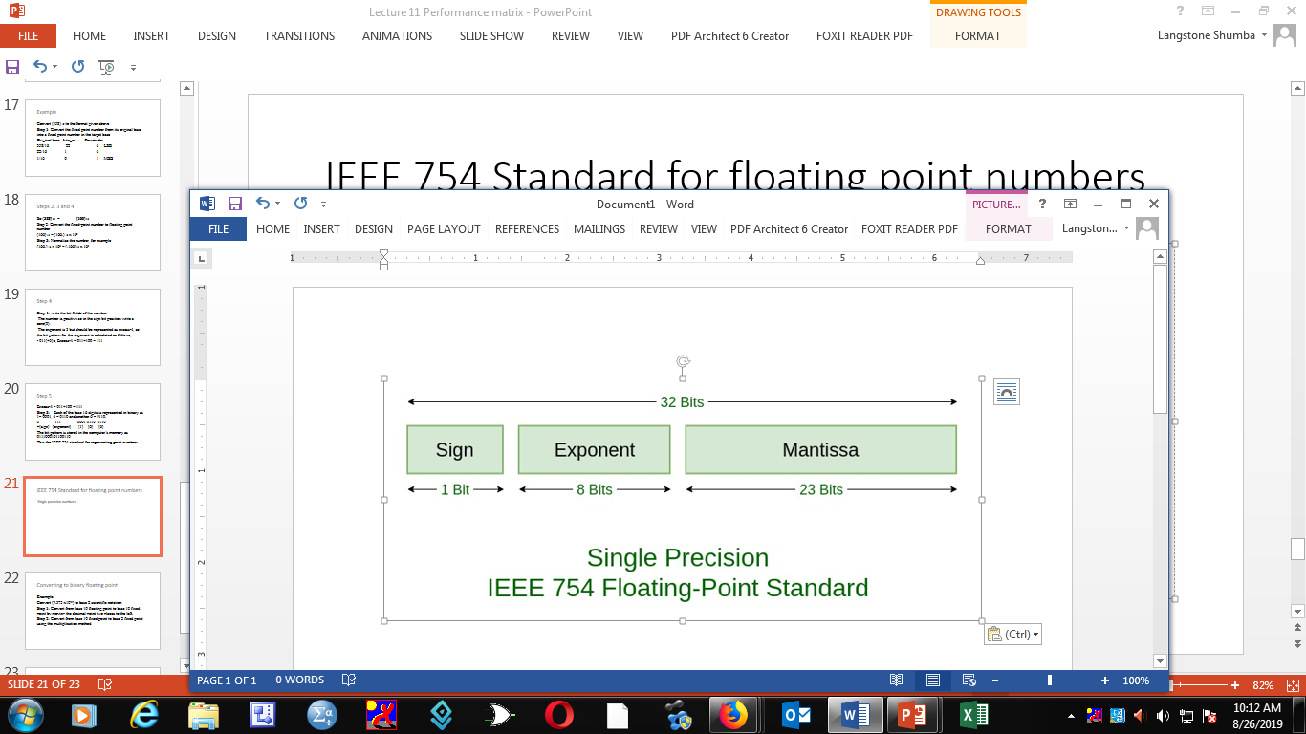
IEEE 754 Standard for floating point numbers
Single precision numbers

Slide 25
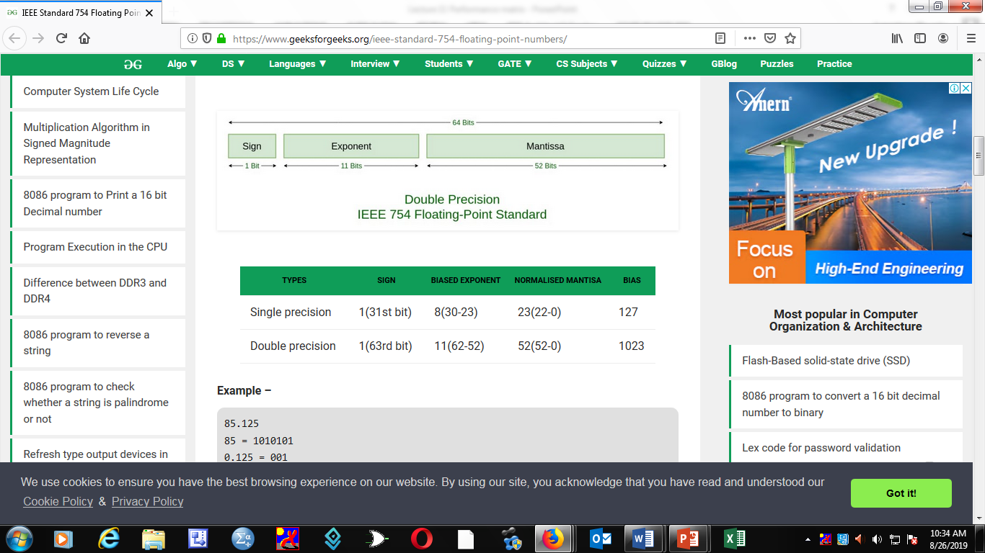
Double Precision floating point

Slide 26
Example of bit positions
Single precision | Sign 1(31st bit) | Exponent 8(30-23) | Mantissa 23(22-0) | Bias 127
Double precision | 1(63rd bit) | 11(62-52) | 52(52-0) | 1023

Slide 27
Example of 85.125₁₀ in IEEE 754 Floating point single precision
Convert 85 to binary : Convert .125 to binary fraction
64 32 16 8 4 2 1 .125 x 2 0.250
1 0 1 0 0 0 1 .250 x 2 0. 500
.500 x 2 1.00
1 0 1 0 0 0 1. 0 0 1 Normalize the number
1 . 0 1 0 0 0 1 0 0 1 x 2⁶

Slide 28
IEEE 754 Floating Point Single Precision
Sign = 0
Biased exponent = 127 + 6 = 133: 128 64 32 16 8 4 2 1
133 in binary = 1 0 0 0 0 1 0 1 1 1 0 0 0 0 1 0 1
Normalized mantissa = 0 1 0 0 0 1 0 0 1
A zero is added to complete the 23 bits in the field
The IEEE 754 Single precision is:
0 1 0 0 0 0 1 0 1 0 1 0 1 0 1 0 0 1 0 0 0 0 0 0 0 0 0 0 0 0 0 0

Slide 29
Hexadecimal presentation
0 1 0 0 0 0 1 0 1 0 1 0 1 0 1 0 0 1 0 0 0 0 0 0 0 0 0 0 0 0 0 0
0 0100 0010 101 0 101 0 01 00 0000 0000 0000 0000
0 4 2 A A 4 0 0 0 0
42AA40000₁₆

Slide 30
IEEE 754 Double Precision
Representing the same number 85.125
Biased exponent is 1023 + 6 = 1029
1029 = 10000000101
Normalized mantissa = 010101001
Add zeros(0s) to complete the 52 bits:
The IEEE 754 Double precision is:
0 10000000101 010101001 00000000000000000000000000
Up to 52 bits (43 zeros after the normalized mantissa)

